Slide 1
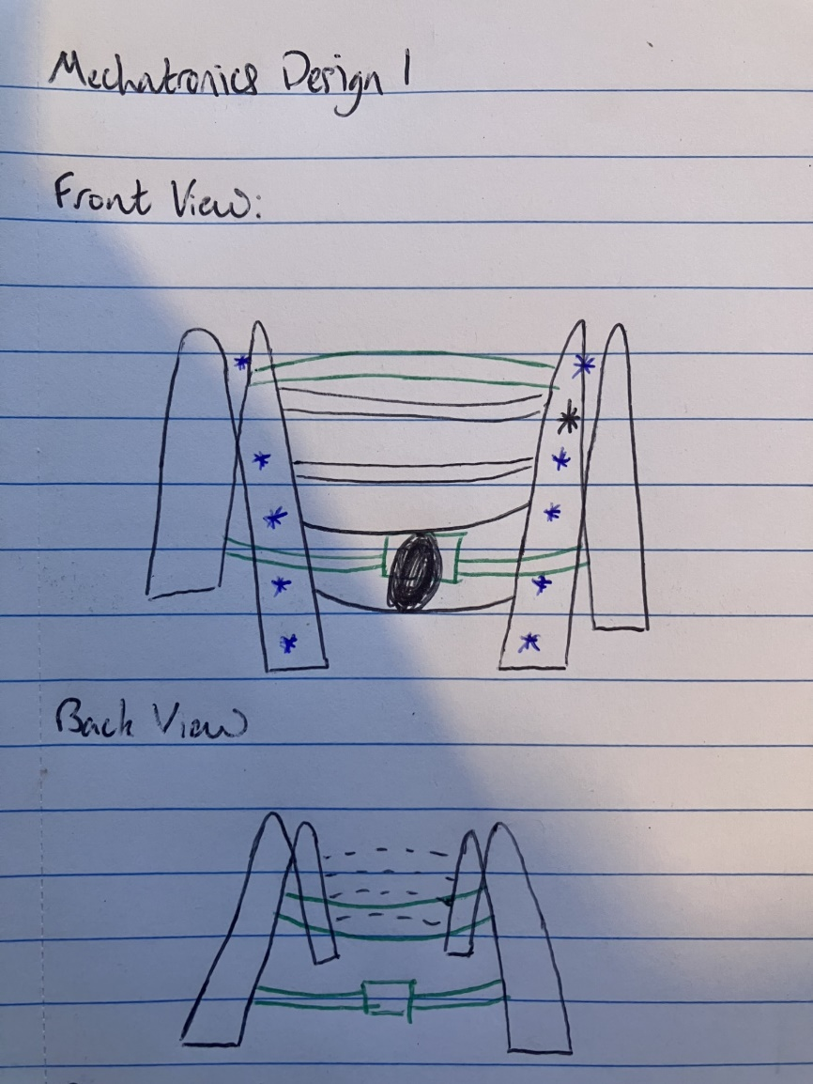

Slide 2
RGB-D Camera

Slide 3
RGB-D Camera
Camera

Slide 4
RGB-D Camera
Camera
Weight, giving instructions for navigation

Slide 5
RGB-D Camera
Camera
Vest, sitting on the users' shoulders
Weight, giving instructions for navigation

Slide 6
RGB-D Camera
Camera
Vest, sitting on the users' shoulders
Weight, giving instructions for navigation
Strapped Connections

Slide 7
RGB-D Camera
Camera
Vest, sitting on the users' shoulders
Weight, giving instructions for navigation
Strapped Connections
Battery Power Pack

Slide 8
Vest, sitting on the users' shoulders

Slide 9
Vest, sitting on the users' shoulders
Strapped Connections

Slide 10
Vest, sitting on the users' shoulders
Strapped Connections
Battery Power Pack

Slide 11
Camera
Vest, sitting on the users' shoulders
Strapped Connections
Battery Power Pack

Slide 12
RGB-D Camera
Camera
Vest, sitting on the users' shoulders
Strapped Connections
Battery Power Pack

Slide 13
RGB-D Camera
Camera
Vest, sitting on the users' shoulders
Weight, giving instructions for navigation
Strapped Connections
Battery Power Pack

